Slide 1
Automatic Precipitation Detection System for Car

Slide 2
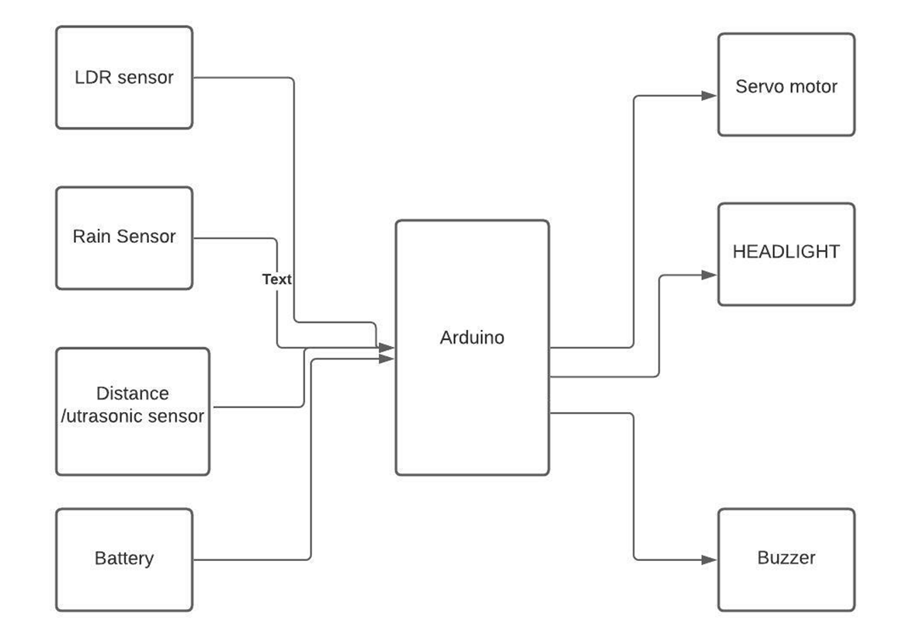
Block Diagram

Slide 3
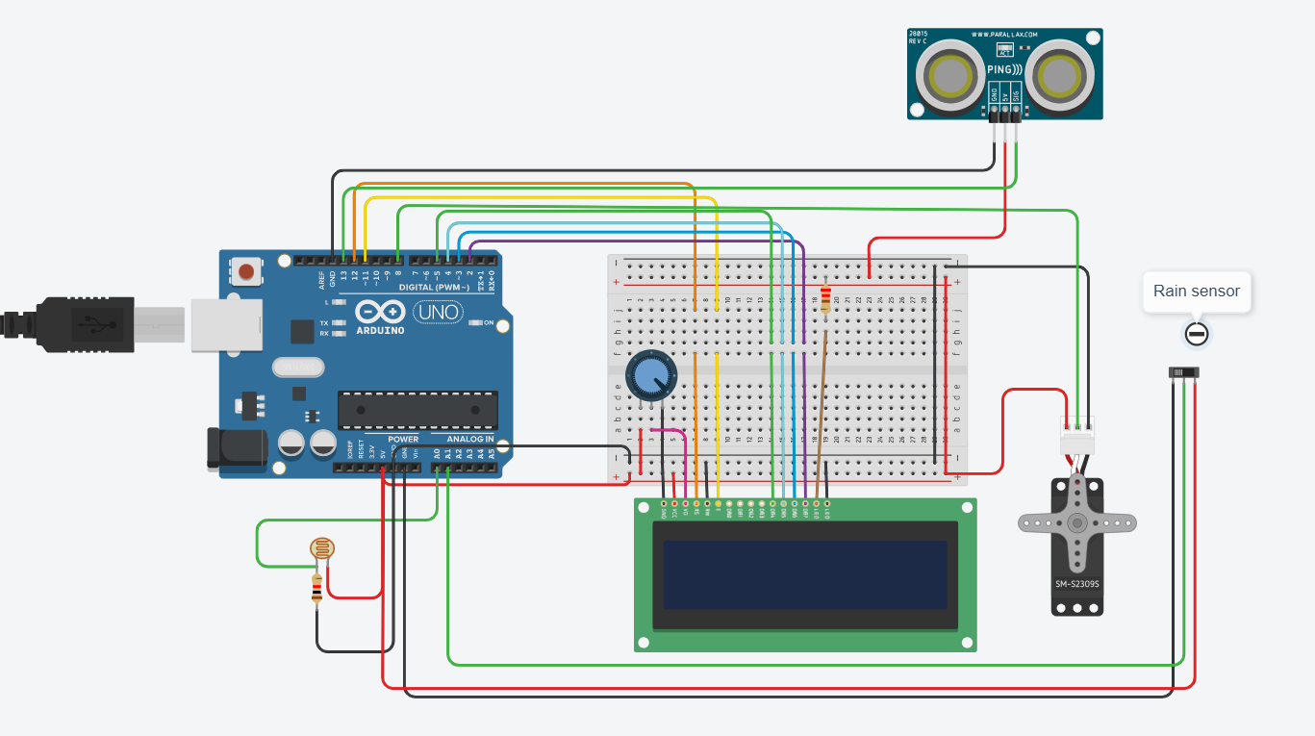
Circuit Diagram of Proposed Model

Slide 4
Software and Hardware Used
Software : Arduino IDE
Hardware : Arduino
Rain Sensor
LDR
LED
Ultra sonic sensor
Buzzer
BreadBoard
Servo motor and Jumper Wires

Slide 5
API USED
(APIs for working with the LCD)
LiquidCrystal lcd(rs, enable, d4, d5, d6, d7) :- To use the LiquidCrystal library, create a named LiquidCrystal object. In this case the object is lcd.
· lcd.begin(cols, rows) :- Initializes the interface to LCD, and specifies dimensions.
o cols: Initialize column position i.e., starting column to display the first character/value.
o rows: Initialize row position i.e., starting row to display/print the first character.
· lcd.setCursor(col, row) :- Position the LCD cursor to set row and column value across 16x2.
- cols: Set column position i.e., column to display the character/value input.
- rows: Set row position i.e., row to display/print the character input.
· lcd. clear() :- Clears the LCD screen and positions the cursor on upper-left corner.
· lcd.print(data)/lcd.write(data) :- The character to write to the display.
- data: The value/character that needs to be displayed onto the LCD.

Slide 6
(APIs for working with the Servo)
· servo.attach(pin) :- Check whether the Servo variable is attached to the Arduino pin. Return true if the servo is attached topin; false otherwise.
- pin: the number of the Arduino pin that the servos attached to.
· servo.write(angle) :- Writes a value to the servo, controlling the shaft accordingly.
- angle: The angle value to write to the servo, from 0 to 180 degrees.

Slide 7
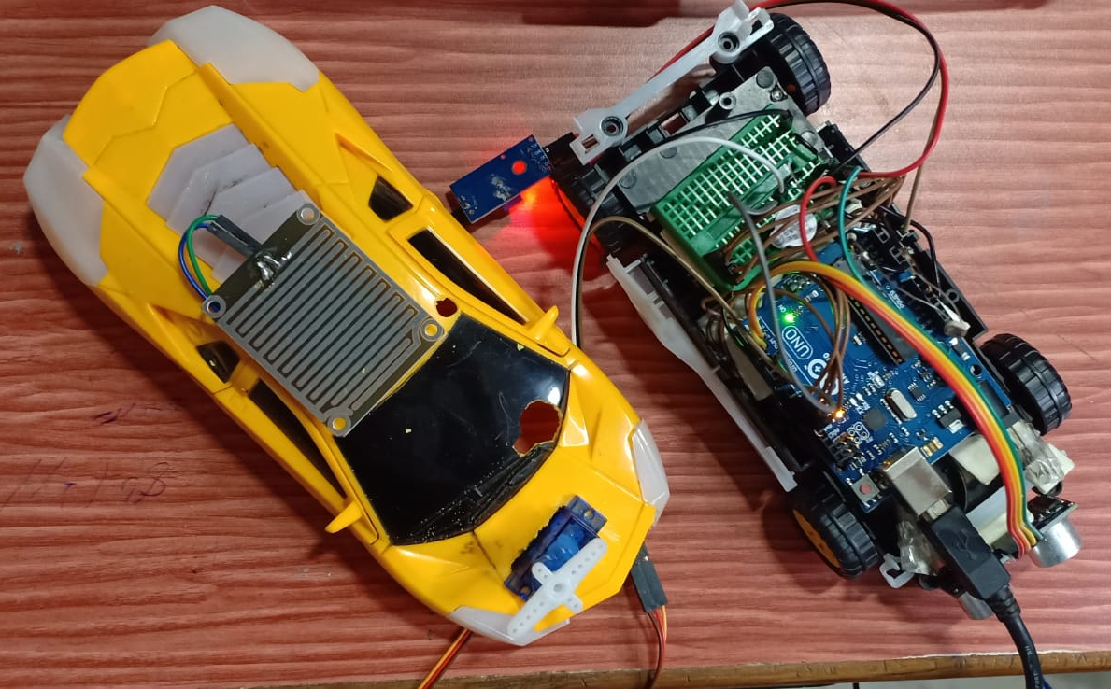

Slide 8
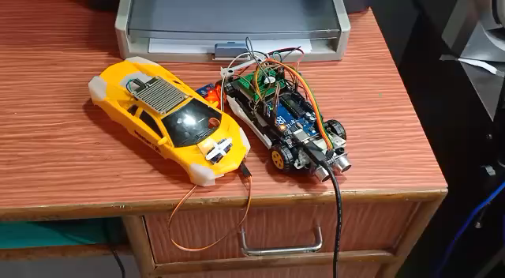
Short Demo Video:

Slide 9
THANK YOU

